Slide 1

NYU TANDON CAREER HUB · FALL 2026
Data Science Bootcamp
Week 1 · Introduction to the Bootcamp & Python Fundamentals
Instructor: Angelin Ann Jacob
Section 1 · Tue Sept 29
Section 2 · Thu Oct 1
Notes:
Welcome everyone. Today has two halves: first, how the next nine weeks work; then we jump straight into Python using a dataset you all helped create.

Slide 2
Part 1 · Introduction to Bootcamp
Get to know your program and timeline for the next 9 weeks!
Data Science Bootcamp · Fall 2026
Notes:
Open the Week 1 notebook in Colab and upload responses.csv from the Files panel. We'll run a full, if modest, exploratory data analysis using only the standard language, so nothing happens by magic.

Slide 3


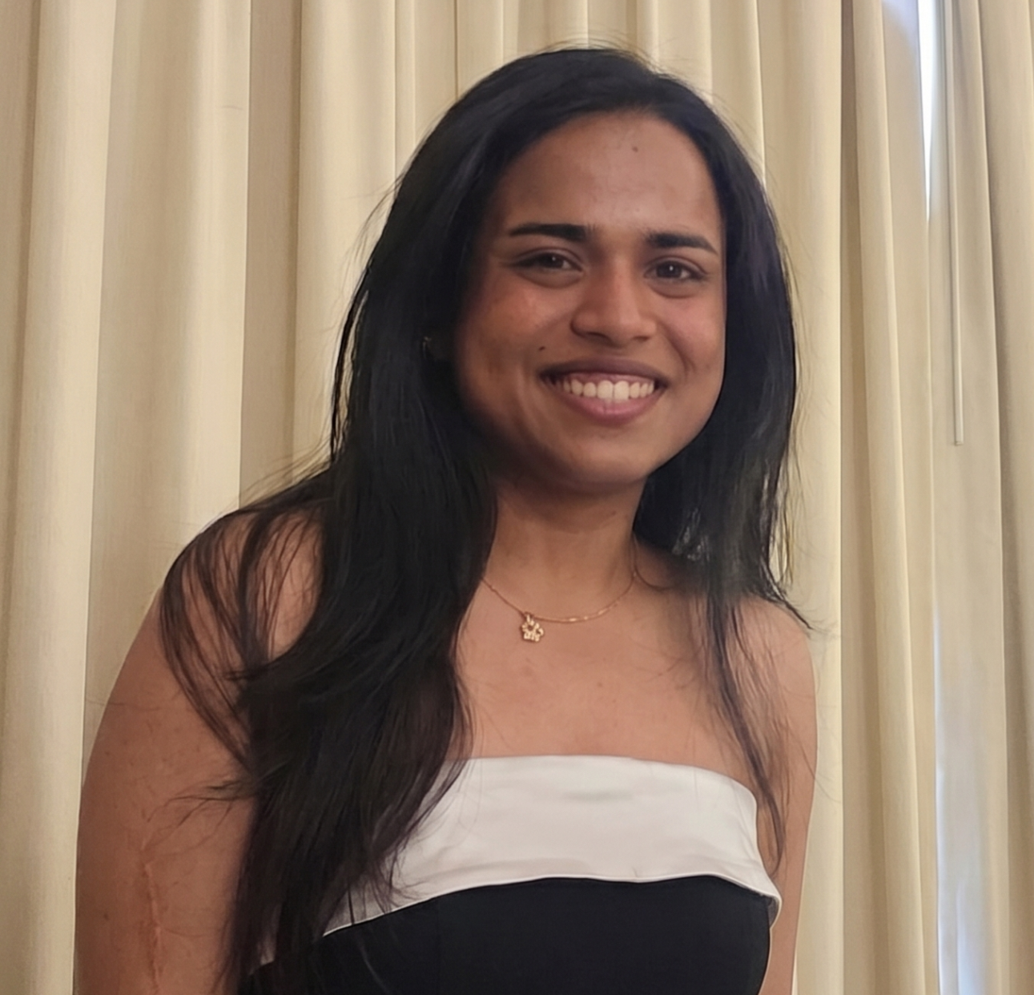


Meet the team! - TCH Data Science Bootcamp
Emily Yeager
Khushi Agarwal
Angelin Ann Jacob
Assistant Director, Career Hub
NYU Tandon School of Engineering
Bootcamp Admin, Career Hub
NYU Tandon School of Engineering
Bootcamp Instructor, Career Hub
NYU Tandon School of Engineering
2 MetroTech Center, Brooklyn, NY 11201
datasciencebootcamp@nyu.edu
Data Science Bootcamp · Fall 2026
01
Notes:
Same topic both days each week; you must stay in your chosen section. Highlighted rows are the two project presentation weeks. No sessions Thanksgiving week, but the team is available for questions and 1:1 coaching, so use that week for your project.

Slide 4
Nine weeks, two sections
Week | Topic | Section 1 · Tue | Section 2 · Thu
1 | Introduction to Bootcamp & Python Fundamentals | Sept 29 | Oct 1
2 | NumPy & Pandas | Oct 6 | Oct 8
3 | Exploratory Data Analysis & Data Visualization | Oct 13 | Oct 15
4 | SQL Fundamentals | Oct 20 | Oct 22
5 | Mid-Program Project Presentations | Oct 27 | Oct 29
6 | Machine Learning Fundamentals, Perceptron | Nov 3 | Nov 5
7 | Probability, Naive Bayes & Linear Regression | Nov 10 | Nov 12
8 | Linear & Logistic Regression, Bias–Variance Trade-off & Gradient Descent | Nov 11 | Nov 19
– | No sessions · Thanksgiving break | – | –
9 | Final Project Presentations | Dec 1 | Dec 3
Stay with the section you registered for: Tue 11:00 AM–1:00 PM ET or Thu 1:00–3:00 PM ET
02
Notes:
Same topic both days each week; you must stay in your chosen section. Highlighted rows are the two project presentation weeks. No sessions Thanksgiving week, but the team is available for questions and 1:1 coaching, so use that week for your project.

Slide 5
How each session runs
01
02
03
04
05
Lecture
Hands-on
Q&A
Take-home
Breaks
Concepts and examples through slides and Jupyter notebooks
Apply it right away: real datasets, Python, analysis and visualization
Ask anything, anytime. The more you ask, the more you learn
Weekly problems on the topic, due one week later
Several short breaks through each two-hour session
The goal every week: theory plus practice you can apply to real-world data science projects.
Data Science Bootcamp · Fall 2026
04
Notes:
The format varies a bit by topic, but this is the usual shape. Please ask questions out loud or in chat; active participation makes the sessions work.

Slide 6
Useful Links
Zoom
Brightspace
GitHub
All sessions are virtual. Log in with your NYU credentials so attendance counts.
Assignments, submissions and the discussion board, monitored Monday to Thursday.
Slides and Colab notebooks for every session.
Email
1:1 coaching
Bootcamp social
datasciencebootcamp@nyu.edu for questions, extensions and attendance approvals.
Optional 30-minute technical interview prep. Book it through Handshake.
Mon, Oct 5, 3–5 PM · 2 MetroTech Center, Room 1054. Drinks, snacks, teammates.
Data Science Bootcamp · Fall 2026
07
Notes:
Coaching path in Handshake: Undergraduate/Graduate Students, then NYU Tandon Career Hub, then Technical Interview Prep Appointment. Discussion board hours are in the syllabus.

Slide 7
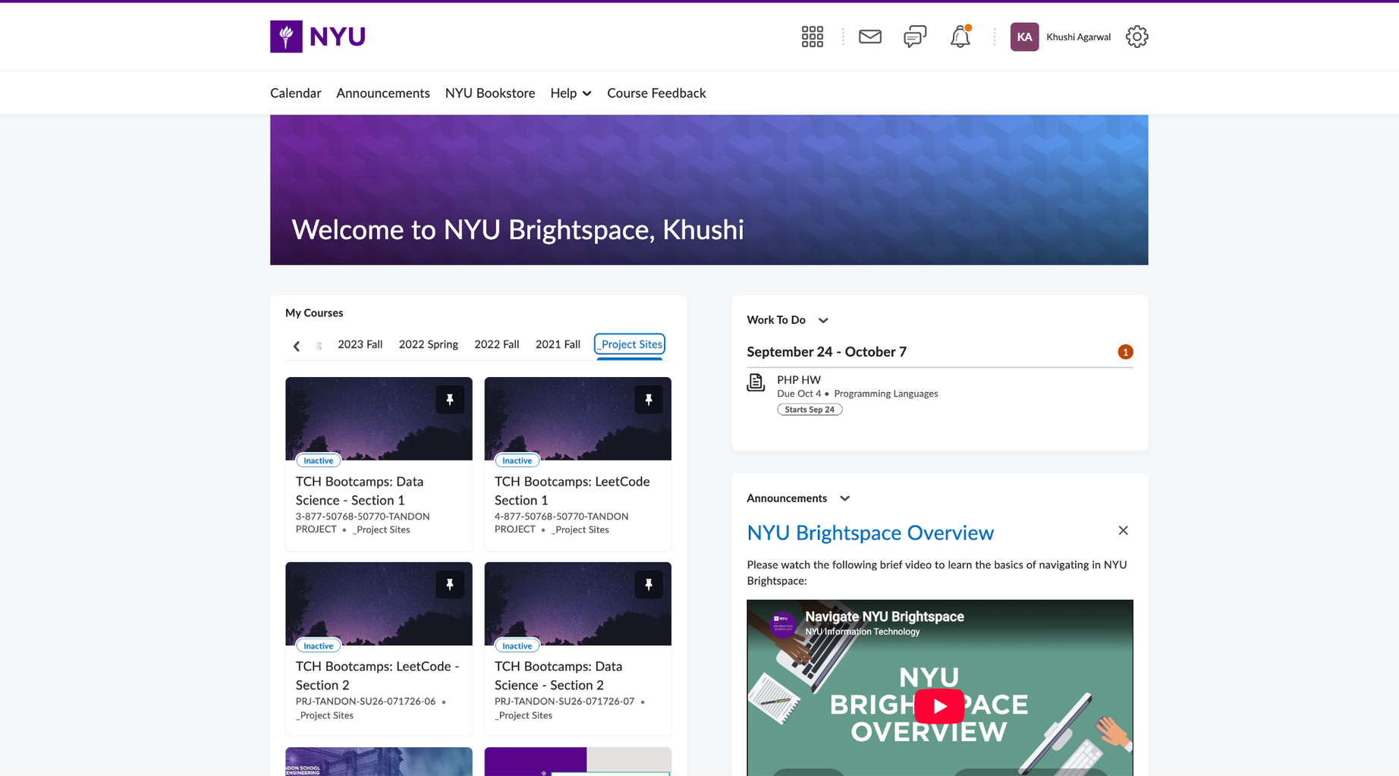
Where things live
Brightspace
Assignments, submissions and the discussion board, monitored Monday to Thursday.
Data Science Bootcamp · Fall 2026
Notes:
The format varies a bit by topic, but this is the usual shape. Please ask questions out loud or in chat; active participation makes the sessions work.

Slide 8
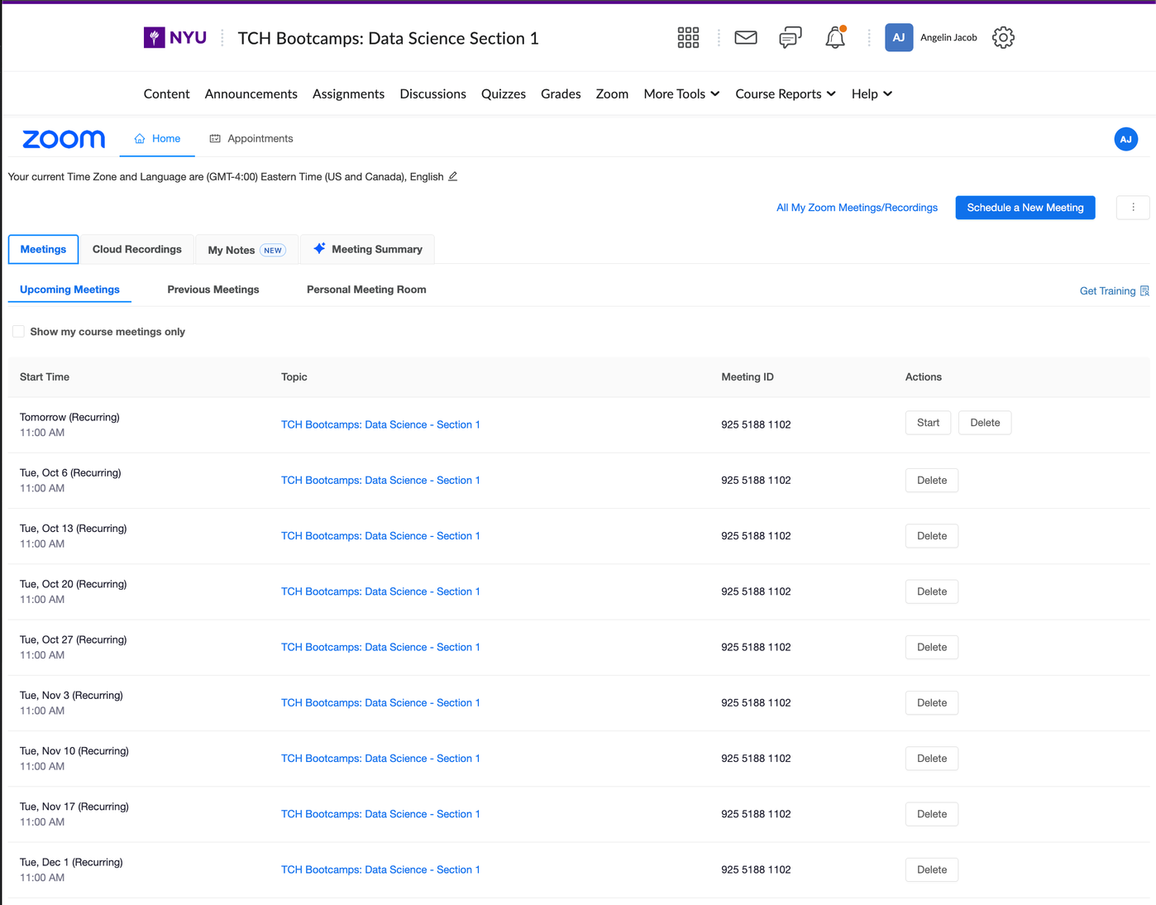
Where things live
Zoom
All sessions are virtual.
Log in with your NYU credentials so attendance counts.Please attend 7 out of 9 sessions to confirm attendance.
Data Science Bootcamp · Fall 2026
Notes:
The format varies a bit by topic, but this is the usual shape. Please ask questions out loud or in chat; active participation makes the sessions work.

Slide 9
Earning the digital credential
A verifiable Accredible badge you can share on LinkedIn, once you meet all five:
Attend 7+ live sessions
Attendance is logged by time on Zoom. Please ONLY use your NYU Zoom SSO login/credentials to access Zoom. Arriving late or leaving early needs prior approval by email, or it counts as absent.
Submit every take-home
On Brightspace, due one week after it's assigned, by 11:59 PM on your section's day.
Send weekly feedback
Fill out the teaching section feedback form after each session.
Form a project group
3–4 members. Submit names and your chosen prompt by Sunday, Oct 18, 11:59 PM.
Present twice
Mid-program on Oct 27/29 and final on Dec 1/3, with every group member present.
Data Science Bootcamp · Fall 2026
05
Notes:
These are the participation criteria from the syllabus. Attendance is tracked by how long you're logged in, so sign in with your NYU credentials. Group sign-up is due October 18.

Slide 10
The project
Groups of 3–4 pick one real-world prompt and present their work to industry professionals. Prizes go to the winning group.
KEY DATES
Mon, Oct 5
Bootcamp social: meet people, form groups
Data Visualization with Air Quality Data
Sentiment Analysis of Social Media Content
Sun, Oct 18
Group names and prompt due, 11:59 PM
Movie Recommendation System
Finance & Economics Time-Series Analysis
Oct 27 / 29
Mid-program presentation and feedback
Dec 1 / 3
Final presentation
Data Science Bootcamp · Fall 2026
06
Notes:
The project is required. Full prompts and judging criteria are in the syllabus. The social on October 5 is the easiest place to find teammates. Mid-program feedback is there to help you revise before finals.

Slide 11
Three roles in data
Today touches all three: we ingest and clean raw form data, summarize it, and form hypotheses.
Data Analyst
Data Engineer
Data Scientist
FOCUS
FOCUS
FOCUS
Organizing data and identifying patterns
Building the infrastructure that moves and stores data
Modeling complex data to support decisions
TYPICAL WORK
TYPICAL WORK
TYPICAL WORK
Reports, dashboards, summary statistics
Collection tools, storage, processing pipelines
Statistical analysis, machine learning, experimentation
CORE SKILLS
CORE SKILLS
CORE SKILLS
Python, SQL, visualization
Python, SQL, ETL, distributed systems
Python, statistics, ML, visualization
Data Science Bootcamp · Fall 2026
09
Notes:
Python is the one skill all three roles share, which is why we start here.

Slide 12
Part 2 · Introduction to Python Fundamentals
Today's dataset is you! 127 bootcamp applications.
Data Science Bootcamp · Fall 2026
Notes:
Open the Week 1 notebook in Colab and upload responses.csv from the Files panel. We'll run a full, if modest, exploratory data analysis using only the standard language, so nothing happens by magic.

Slide 13

Who's in the room
127
54%
80%
72%
applications to this cohort
call themselves beginners (68 of 127)
are master's students (101 of 127)
already list Python as a language they know (92)
Most common major: Computer Science (48) · Most common time budget: 5–7.5 hours a week (81)
Source: bootcamp application form, 127 anonymized responses
Data Science Bootcamp · Fall 2026
02
Notes:
A quick portrait of the cohort, straight from your application forms. Roughly half of you are beginners and half intermediate, so expect a mix of review and new material. We'll compute several of these numbers ourselves in plain Python later today.

Slide 14
Today's agenda Each part introduces one group of language features and uses it on the data
Part | Python concept | Question it answers
0 | Working in a notebook | How do we run code?
1 | Variables and primitive types | What kind of data did the form collect?
2 | Operators and expressions | How do we tell a late-night submission from an early-morning one?
3 | Lists, tuples, dictionaries, sets | What does a single application look like?
4 | Conditionals and loops | When did people apply? Who skipped questions? What do we study?
5 | String, list and dictionary methods | When did everyone submit? Which languages do we already know?
6 | Functions and error handling | Can we build a small analytics toolkit? What excites applicants most?
7 | Scope | Where do variables live, and when do they disappear?
Data Science Bootcamp · Fall 2026
10
Notes:
This mirrors the sections of the Week 1 notebook. We end by assembling everything into a one-page summary of the applicant pool.

Slide 15
Before next week
Take-home
Feedback form
Week 2: NumPy & Pandas
The exercises at the end of today's notebook. Submit on Brightspace within one week, by 11:59 PM.
Fill it out after today's session. It counts toward your credential.
Everything we did today with loops and dictionaries, pandas does in a line or two.
See you at the social: Mon, Oct 5, 3–5 PM · 2 MetroTech Center, Room 1054
Data Science Bootcamp · Fall 2026
Notes:
Take-home exercises are at the end of the notebook, with an extended challenge for anyone who wants more. Week 2 is Oct 6 for Section 1 and Oct 8 for Section 2.

